Slide 1
INTRODUCTION TO COMPUTER ORGANIZATION
Prepared By
Dr. Tajinder Kaur
AP,DICE

Slide 2
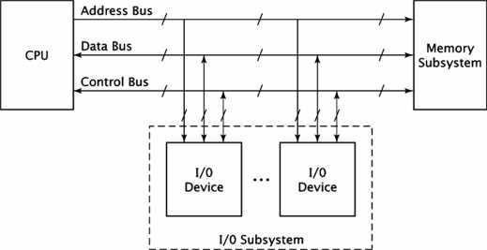
BASIC COMPUTER ORGANIZATION:
The basic computer organization has three main components:
CPU
Memory subsystem
I/O subsystem.
The generic organization of these components is shown in the figure below.
Fig 1.1 Generic computer Organization

Slide 3
System bus:
Physically the bus is a set of wires. The components of a computer are connected to the buses. To send information from one component to another the source component outputs data on to the bus. The destination component then inputs the data from bus.
The system has three buses
Address bus
Data bus
Control bus
The uppermost bus in this figure is the address bus. When the CPU reads data or instructions from or writes data to memory, it must specify the address of the memory location it wishes to access.
Data is transferred via the data bus. When CPU fetches data from memory it first outputs the memory address on to its address bus. Then memory outputs the data onto the data bus. Memory then reads and stores the data at the proper locations.
Control bus carries the control signal. Control signal is the collection of individual control signals. These signals indicate whether data is to be read into or written out of the CPU.

Slide 4
Instruction cycles:
The instruction cycle is the procedure a microprocessor goes through to process an instruction.
First the processor fetches or reads the instruction from memory. Then it decodes the instruction determining which instruction it has fetched. Finally, it performs the operations necessary to execute the instruction.
After fetching it decodes the instruction and controls the execution procedure. It performs some Operation internally, and supplies the address, data & control signals needed by memory & I/O devices to execute the instruction.
The READ signal is a signal on the control bus which the microprocessor asserts when it is ready to read data from memory or I/O device.
When READ signal is asserted the memory subsystem places the instruction code be fetched on to the computer system’s data bus. The microprocessor then inputs the data from the bus and stores its internal register.
READ signal causes the memory to read the data, the WRITE operation causes the memory to store the data.

Slide 5
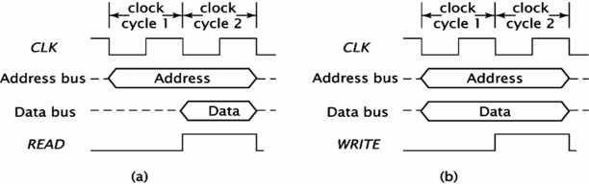
Memory Read and Memory Write Operations
Fig 1.2: Timing diagram for memory read and memory write operations

Slide 6
In the above figure the top symbol is CLK. This is the computer system clock. The processor uses the system clock to synchronize its operations.
In fig (a) the microprocessor places the address on to the bus at the beginning of a clock cycle, a 0/1 sequence of clock. One clock cycle later, to allow for memory to decode the address and access its data, the microprocessor asserts the READ control signal. This causes the memory to place its data onto the system data bus.
During this clock cycle, the microprocessor reads the data off the system bus and stores it in one of the registers. At the end of the clock cycle it removes the address from the address bus and deasserts the READ signal. Memory then removes the data from the data from the data bus completing the memory read operation.
In fig(b) the processor places the address and data onto the system bus during the first clock pulse. The microprocessor then asserts the WRITE control signal at the end of the second clock cycle. At the end of the second clock cycle the processor completes the memory write operation by removing the address and data from the system bus and deasserting the WRITE signal.
I/O read and write operations are similar to the memory read and write operations. Basically the processor may use memory mapped I/O and isolated I/O.
In memory mapped I/O it fallows the same sequence of operations to input data as to read from or write data into memory.
In isolated I/O fallow same process but have a second control signal to distinguish between I/O and memory accesses. For example in 8085 microprocessor has a control signal called IO/ . The processor set IO/ to 1 for I/O read and write operations and 0 for memory read and write operations.
.

Slide 7
CPU ORGANIZATION:
Central processing unit (CPU) is the electronic circuitry within a computer that carries out the instructions of a computer program by performing the basic arithmetic, logical, control and input/output (I/O) operations specified by the instructions.
In the computer all the major components are connected with the help of the system bus.
Data bus : Data bus is used to shuffle data between the various components in a computer system.
Address bus : To differentiate memory locations and I/O devices the system designer assigns a unique memory address to each memory element and I/O device. When the software wants to access some particular memory location or I/O device it places the corresponding address on the address bus. Circuitry associated with the memory or I/O device recognizes this address and instructs the memory or I/O device to read the data from or place data on the data bus. Only the device whose address matches the value on the address bus responds.
Control bus : The control bus is an eclectic collection of signals that control how the processor communicates with the rest of the system. The read and write control lines control the direction of data on the data bus

Slide 8
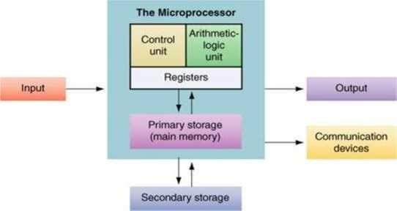
When both contain logic one the CPU and memory-I/O are not communicating with one another.
If the read line is low (logic zero) the CPU is reading data from memory (that is the system is transferring data from memory to the CPU).
If the write line is low the system transfers data from the CPU to memory.
The CPU controls the computer. It fetches instructions from memory, supply the address and control signals needed by the memory to access its data.
Internally, CPU has three sections as shown in the fig below
Fig 1.3: CPU Organization

Slide 9
The register section, as its name implies, includes a set of registers and a bus or other communication mechanism.
The register in a processor’s instruction set architecture are found in the section of the CPU.
The system address and data buses interact with this section of CPU. The register section also contains other registers that are not directly accessible by the programmer.
The fetch portion of the instruction cycle, the processor first outputs the address of the instruction onto the address bus. The processor has a register called the “program counter”.
The CPU keeps the address of the next instruction to be fetched in this register. Before the CPU outputs the address on to the system bus, it retrieves the address from the program counter register.
At the end of the instruction fetch, the CPU reads the instruction code from the system data bus.
It stores this value in an internal register, usually called the “instruction register”.
The arithmetic / logic unit (or) ALU performs most arithmetic and logic operations such as adding and ANDing values. It receives its operands form the register section of the CPU and stores its result back in the register section.

Slide 10
Just as CPU controls the computer, the control unit controls the CPU. The control unit receives some data values from the register unit, which it used to generate the control signals. This code generates the instruction codes & the values of some flagregisters.
The control unit also generates the signals for the system control bus such as READ, WRITE, IO/ signals.

Slide 11
Thanks & Any query ?

